Slide 1
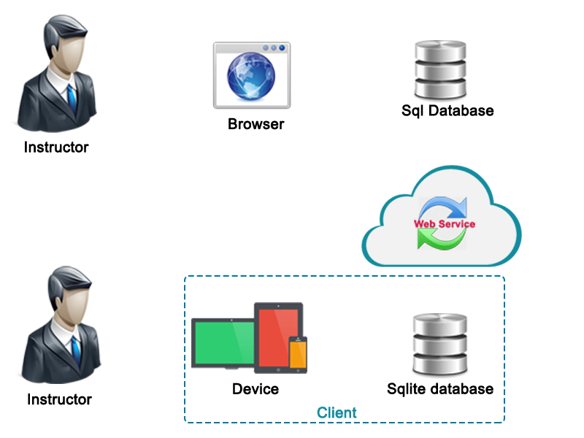



Process
3
5
Flow sql server
Flow sqlite
Using website
4
2
4
5
2
1
3
1
6

Slide 2
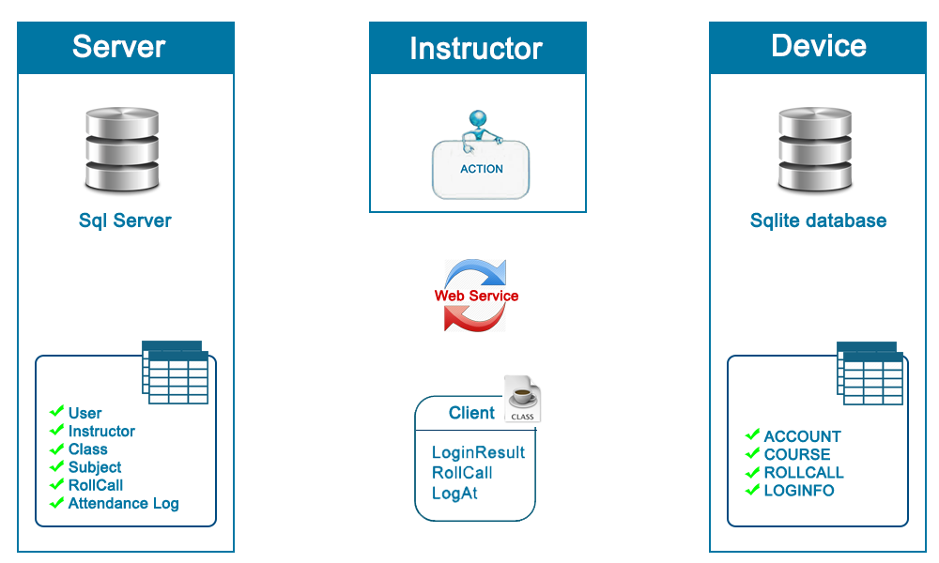
Managements data sync
Online mode
Offline mode
Sync database

